Slide 1
Static code analysis
Rodrigo de Pedro

Slide 2

What is it?
Static: not done in runtime, unlike dynamic code analysis.
Code: referent to a program, a set of them, or an entire system.
Analysis: check for problems and possible improvements.
So, SCA is a tool which looks for errors on a specific set of code, before the execution.

Slide 3
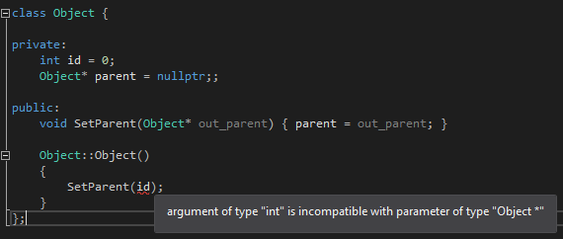
You are already using it!

Slide 4
Why should I use SCA tools?

Slide 5
Identify anomalies or flaws in the code

Slide 6

Ensure security against hack attempts

Slide 7
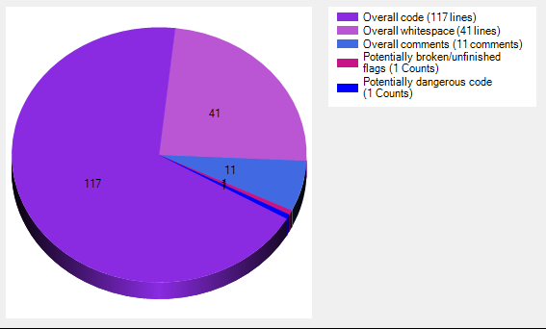
Calculate performance metrics

Slide 8
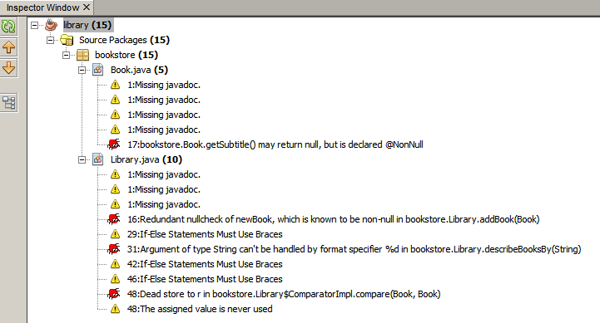
Provide meaningful error descriptions

Slide 9
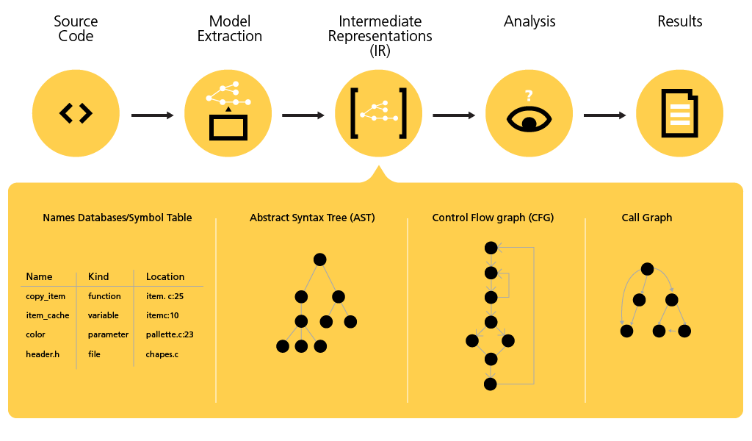
Analyze structures and dependencies

Slide 10
How do they work?

Slide 11
Tools (Online)
Some online SCA tools allow to copy the code fragment to analyze directly into their webpage.
However, the main benefit of online tools comes when used in sync with a code storage service (Git, Bitbucket).
This allows to automatic and continuous evaluation of the code written by all team members.
Some online SCA tools are:
Coverity ( Paid/ integrated with Git/ supports Java, C++, C# Python and Ruby)
QonCAT (Paid/ supports multiple languages / quality analysis and metrics)

Slide 12

Coverity
Let's check how does work Coverity, an online SCA tool. The functionality described in the video can be extrapolated to most current SCA tools in the market.
https://community.synopsys.com/s/article/Coverity-Tutorial-Introduction-to-Coverity

Slide 13
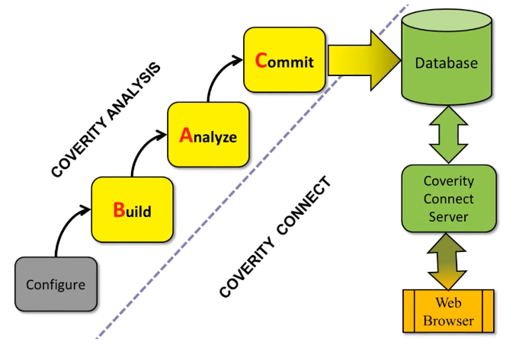
Coverity: the BAC workflow
0. Configure: programming language, compiler...
1. Build: Coverity build, not Visual Studio!
2. Analyze: run the algorithm.
3. Commit: send it to shared Database

Slide 14
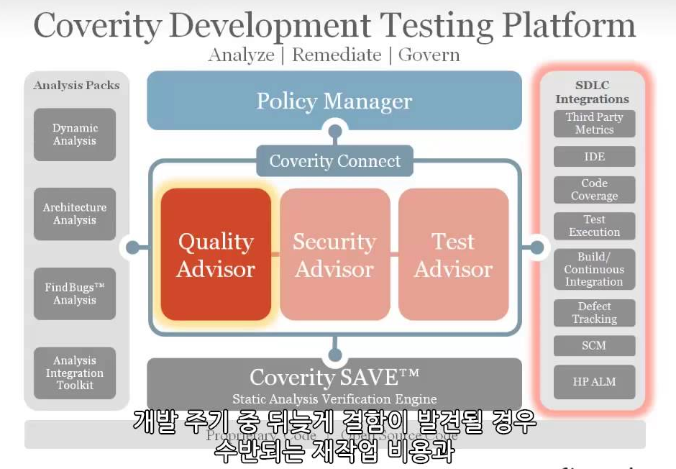
Coverity: features

Slide 15
Tools (Offline)
Most commonly used compilers, as Visual Studio, feature their own SCA tool.
However, dedicated SCA programs can provide better performance, support more programming languages or display better error definitions.
Some offline SCA tools are:
CodeSonar ( Paid / Static and binary analysis / analysis of third-party code included)
CheckMark products ( Paid / lots of features / dedicated products / supports +20 languages)
CppCheck ( Free / we will check it later )

Slide 16

CppCheck
Pros:
Completely free
Highly-customizable
Can analyze non-standard code
Visual Studio plug-in (here)
Cons:
Rudimentary, few features
False positives

Slide 17
Exercises

Slide 18
TODOs
Let's implement some SAC tools into our work.
One member per group can implement it into their current project for the Proj 2 subject.
The others can use any project they own or use the sample code attached to this research .zip file.

Slide 19
TODO 1
Go to the github repository of this research.
Download Exercises and CppCheck + VGC in the releases tab.

Slide 20
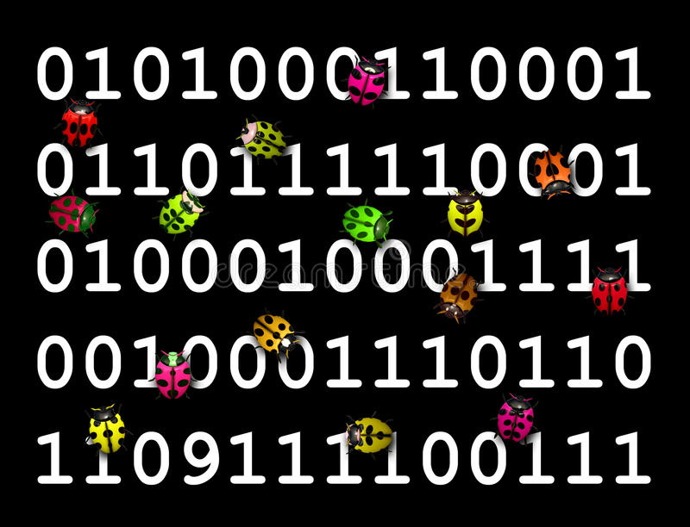
Spot the bugs!
1.
2.
3.

Slide 21
TODO 2
CppCheck runs locally, so you need the project files. If you don't have them in your computer, download them.
Create a folder on your desktop called bugtracking.
Start CppCheck and click on New Project.
Choose the new folder as location and choose a name for the CppCheck file folder.

Slide 22
TODO 3
A project configuration pop-up will appear.
Go to the first tab paths and defines.
There, choose import project and browse to your solution file (.sln) inside your VS project folder.
Make sure that analyze all Visual Studio configurations is checked.

Slide 23
TODO 4
Go to the next tab Checking.
Select a build dir (the folder where our analysis results will be stored). This path is relative to the CppCheck project file folder which we have created in TODO 2.
Choose the target platform of the project.
Below, check all libraries your project uses or will use (most likely SDL and windows).

Slide 24
TODO 5
On the next tab, Warning options, you can add excluded paths and errors.
You will most likely don't want third-party libraries to be checked for errors, so you can add their paths here now.
By now, we will not exclude any error so we can see all possible issues CppCheck can find.
Click Done on the project configuration tab. Accept if you are asked to create the build dir folder.

Slide 25
TODO 6
Right when you end configuring your CppCheck files, the analysis will start.
Once finished, a list with all found errors will be displayed.
You can also access error files inside the build dir folder specified previously.
Before proceeding to check the errors, let's configure a bit more our CppCheck.

Slide 26
TODO 7
Inside the CppCheck menu, go to Edit/preferences.
In General, check all options but Enable inline supressions.
In Reports, check both options.
Once finished, close the Preferences tab.

Slide 27
TODO 8
CppCheck can use .cfg files to further configure the analysis.
Go to the folder where our CppCheck file is (TODO 2), create a new Text document and call it configuration.cfg
At the start of the file, write: <?xml version="1.0"?>

Slide 28
TODO 9
Open the CppCheck menu and go to View/Library Editor. There, go to Open and add the .cfg file we were editing.
There you can add functions by writing their name and argument number.
Then, double click in any argument to set the rules it must follow. Save once you have finished editing.
Remember to go to File/Edit Project -> Checking tab, and make sure the library "config" is checked to start using it.

Slide 29
TODO 10
Let's check the results from the CppCheck analysis. Only a single bug is found related to a const attribute.
However, CppCheck does not find a memory leak that is ocurring in the code.
Let's try another SAC tool: install Visual Code Grapper from the research .zip (install it in a desktop folder for quick access).

Slide 30
TODO 11
Start the program, and make sure that the language in Settings is set to C/C++.
Go to File/New target directory and search the folder where the source files are located.
Press Scan/Full Scan to start the analysis.

Slide 31
TODO 12
As you can see, VCG has found a bug that CppCheck did not found: the memory leak.
It does also analyze comments in search of potential dangers.
However, we can also see that VCG has not found the const bug that CppCheck did before.
In fact, any of them has found a signed/unsigned mismatch bug.

Slide 32
Conclusions
Although they are a very useful tool for programmers, SCA programs are not always able to find all bugs, so we should always double check and manually review for errors.
Visual Studio integrated SCA offers quite good results while still being free to use.
Paid SCA tools can find several more bugs than free programs and allow to online features, so they are a good choice for greater companies.

Slide 33
Homework
Check the configuration options of VCG, it features code charts and other useful functionality.
If you wish, you can check the CppCheck documentation and further tweak your .cfg file for more precise analysis.
Keep in mind that some paid SCA tools (like CodeSonar) offer a free trial that could be useful to review your Proj 2 assignment before the Alpha release.

Slide 34
Resources
http://istqbexamcertification.com/what-is-static-analysis-tools-in-software-testing/
https://en.wikipedia.org/wiki/Static_program_analysis
https://cs.au.dk/~amoeller/spa/
http://cppcheck.sourceforge.net/#documentation
https://community.synopsys.com/s/

Slide 35
Thanks for your time!

